Slide 1
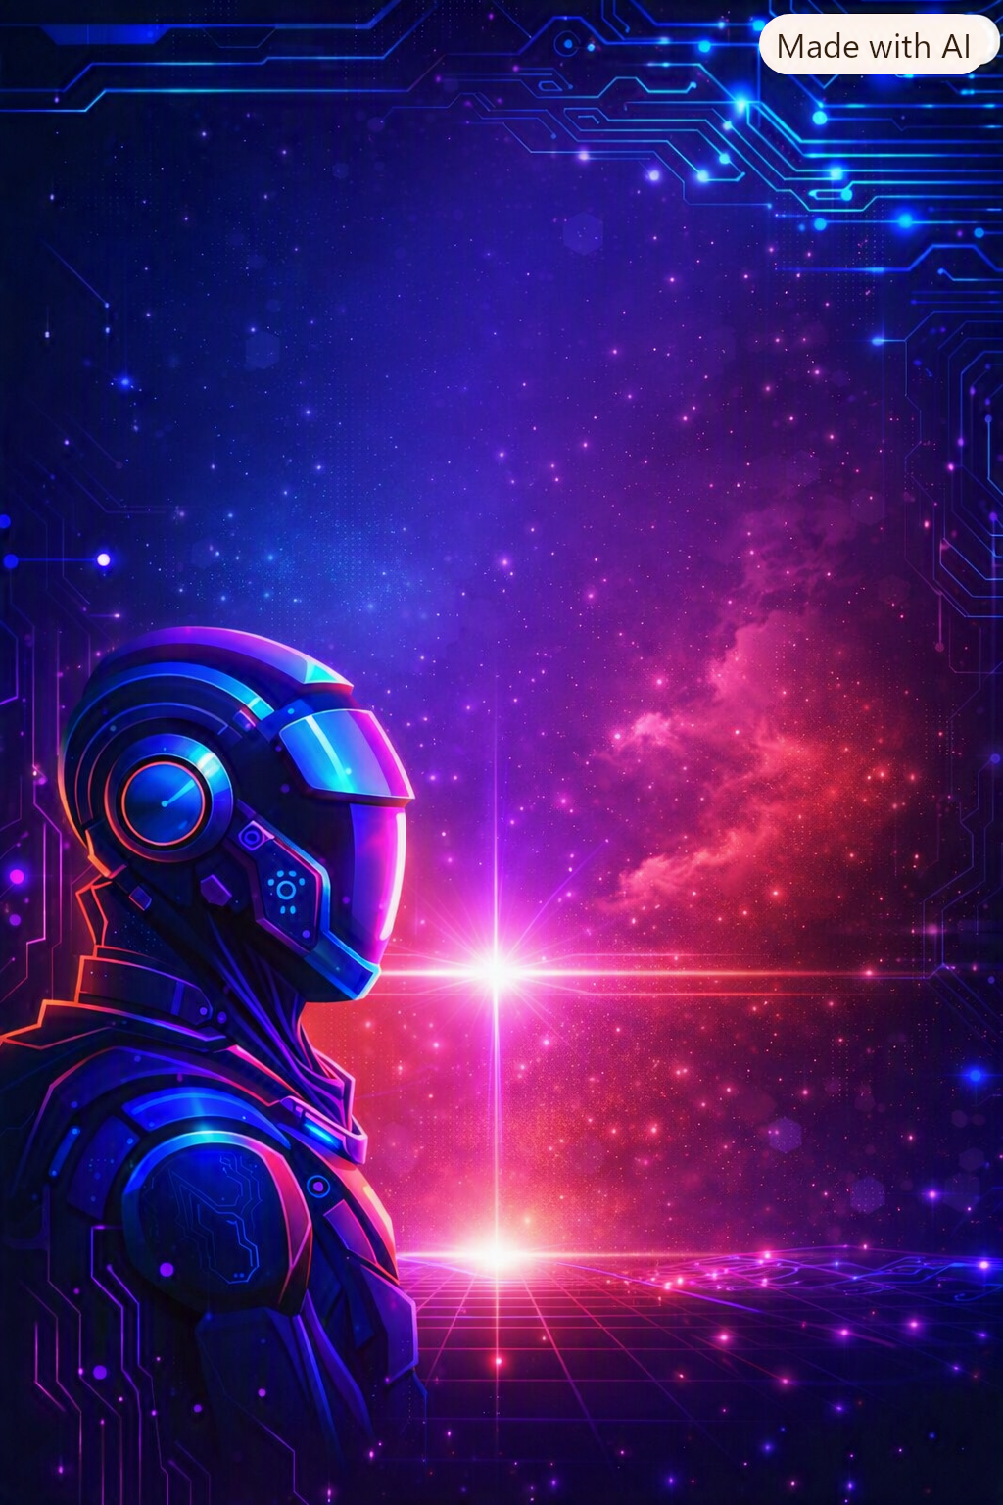
DEPARTMENT OF COMPUTER SCIENCE INVITES ALL ITS STUDENTS TO
IT FEST
2026
📅 1-2 SEPTEMBER 2026 •10:00 AM ONWARDS
📍CS DEPARTMENT,AMU
💻 Code Wars
🧠 Tech Quiz
🐞 Debugging
🎮 Gaming
✨ Many More
THINK.CODE.INNOVATE
BE THE FUTURE!

